Slide 1
Forecasting Stock Exchange value using Artificial Neural Network
Presented by: Amit Jena
Supervisor: Mr. Mukul Priyadarshi

Slide 2
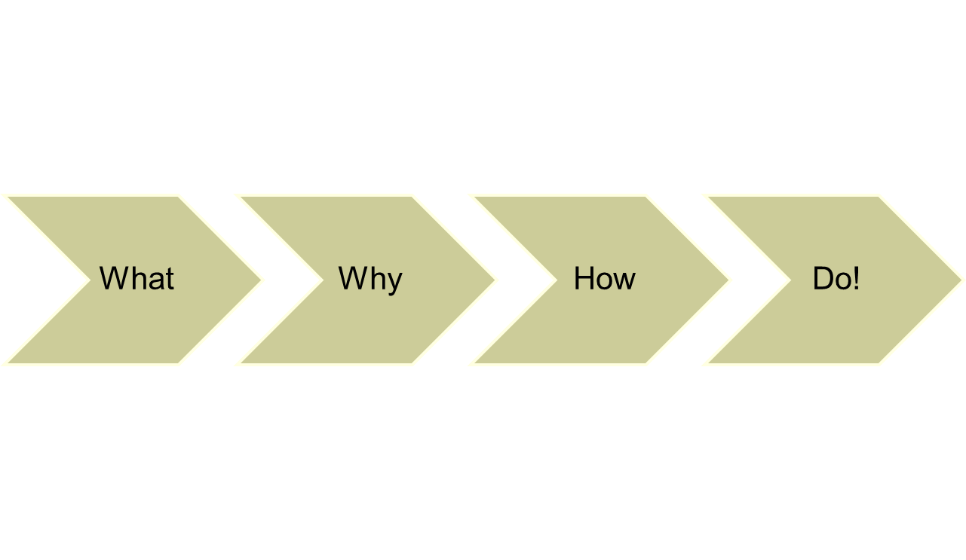

Slide 3
What is Artificial Neural Network?

Slide 4
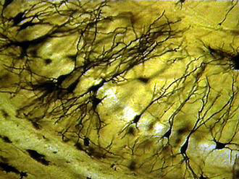
Biological inspiration
Dendrites
Soma (cell body)
Axon

Slide 5
Biological inspiration
dendrites
axon
synapses
The information transmission happens at the synapses.

Slide 6
Biological inspiration
The spikes travelling along the axon of the pre-synaptic neuron trigger the release of neurotransmitter substances at the synapse.
The neurotransmitters cause excitation or inhibition in the dendrite of the post-synaptic neuron.
The integration of the excitatory and inhibitory signals may produce spikes in the post-synaptic neuron.
The contribution of the signals depends on the strength of the synaptic connection.

Slide 7
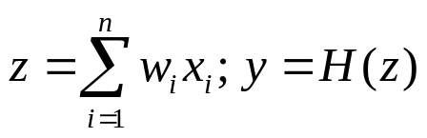
Artificial neurons
Neurons work by processing information. They receive and provide information in form of spikes.
x₁
x₂
x₃
…
x_{n-1}
x_{n}
w₁
Output
w₂
Inputs
y
w₃
.
.
.
w_{n-1}
w_{n}
The McCullogh-Pitts model

Slide 8
Artificial neurons
The McCullogh-Pitts model:
  spikes are interpreted as spike rates;
  synaptic strength are translated as synaptic weights;
  excitation means positive product between the incoming spike rate and the corresponding synaptic weight;
  inhibition means negative product between the incoming spike rate and the corresponding synaptic weight;

Slide 9
Artificial neural networks
Output
Inputs
An artificial neural network is composed of many artificial neurons that are linked together according to a specific network architecture. The objective of the neural network is to transform the inputs into meaningful outputs.

Slide 10
Why to use ANN??

Slide 11
Why to use ANN??
Nonlinearity
Input-Output mapping
Adaptivity
Evidential response
Contextual Information
Fault tolerance
VLSI implementation
Neurobiological Analogy
Notes:
Robustness and fault tolerance: The decay of nerve cells does not seem to affect the performance significantly.
Flexibility: The network automatically adjusts to a new environment without using any preprogrammed instructions.
Ability to deal with a variety of data situations: The network can deal with information that is fuzzy, probabilistic, noisy and inconsistent.
Collective computation: The network performs routinely many operations in parallel and also a given task in a distributed manner.

Slide 12
HOW do we do it?

Slide 13
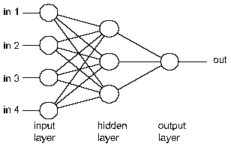
Basic ANN Architecture

Slide 14
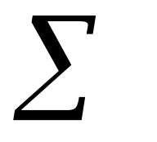
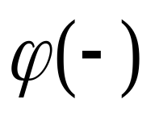

The Neuron Diagram
Bias
b
x₁
w₁
Activation
function
Induced
Field
v
Output
y
Input
values
x₂
w₂
Summing
function
x_{m}
w_{m}
weights

Slide 15
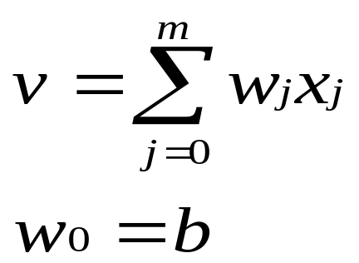
Bias of a Neuron
The bias b has the effect of applying a transformation to the weighted sum u
        v = u + b
The bias is an external parameter of the neuron. It can be modeled by adding an extra input.
v is called induced field of the neuron

Slide 16

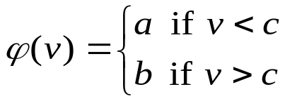
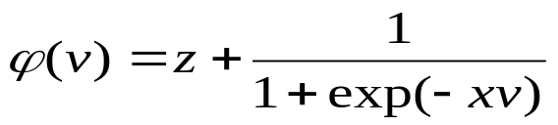
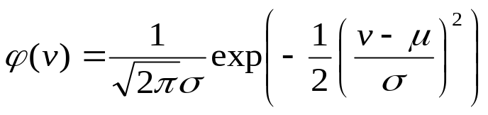
Neuron Models
The choice of activation function determines the neuron model.
Examples:
step function:
sigmoid function:
Gaussian function:

Slide 17
Step Function
b
a
c

Slide 18
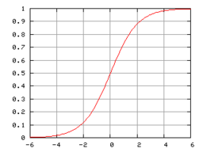
Sigmoid function

Slide 19

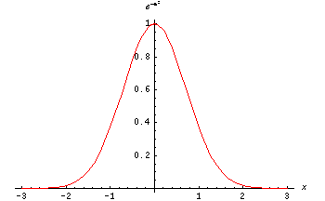
The Gaussian function is the probability function of the normal distribution. Sometimes also called the frequency curve.

Slide 20
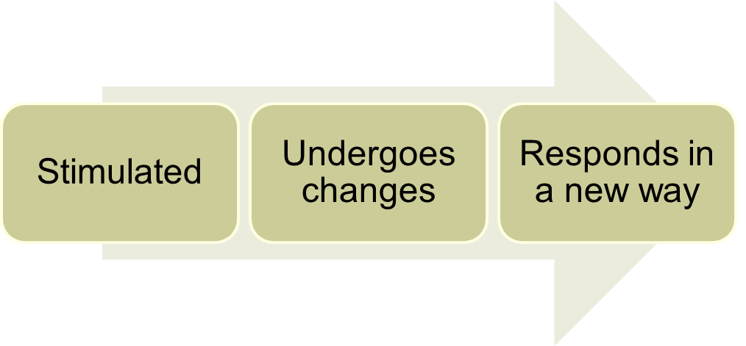
Learning in the context of ANN
Learning is a process by which the free parameters of a neural network are adapted through a process of stimulation by the environment in which the network is embedded. The type of learning is determined by the manner in which the parameter changes take place.

Slide 21

Basic Types of Learning
Neural Nets
Supervised
Learning
Unsupervised
Learning
X

Slide 22
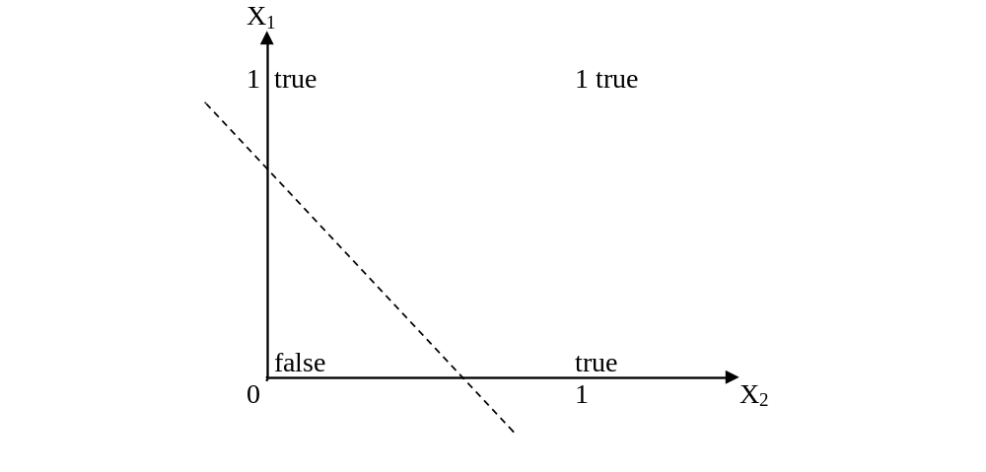
Boolean function OR – Linearly separable

Slide 23
XOR – Non linearly separable function
A typical example of non-linearly separable function is the XOR that computes the logical exclusive or..
This function takes two input arguments with values in {0,1} and returns one output in {0,1},
Here 0 and 1 are encoding of the truth values false and true,
The output is true if and only if the two inputs have different truth values.
XOR is non linearly separable function which can not be modeled by perceptron.
For such functions we have to use multi layer feed-forward network.

Slide 24
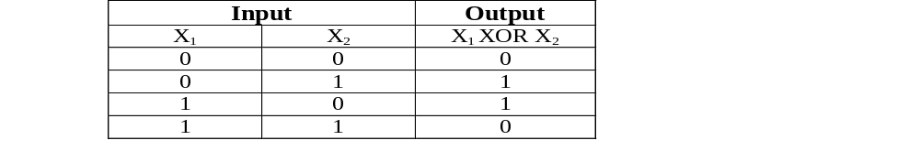
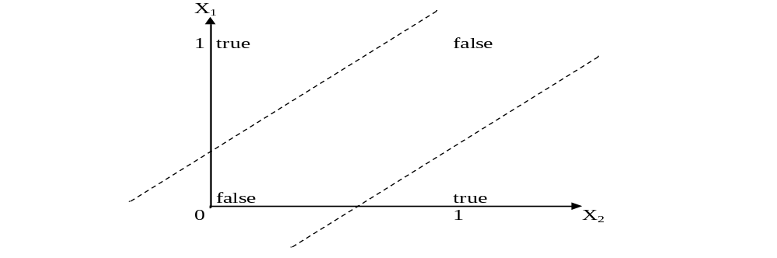
These two classes (true and false) cannot be separated using a line. Hence XOR is non linearly separable.

Slide 25
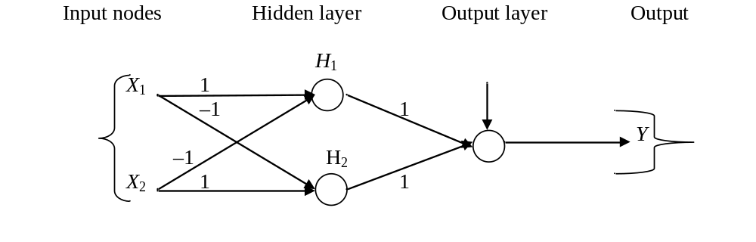
FFNN for XOR
The ANN for XOR has two hidden nodes that realizes this non-linear separation and uses the sign (step) activation function.
Arrows from input nodes to two hidden nodes indicate the directions of the weight vectors (1,-1) and (-1,1).
The output node is used to combine the outputs of the two hidden nodes.

Slide 26
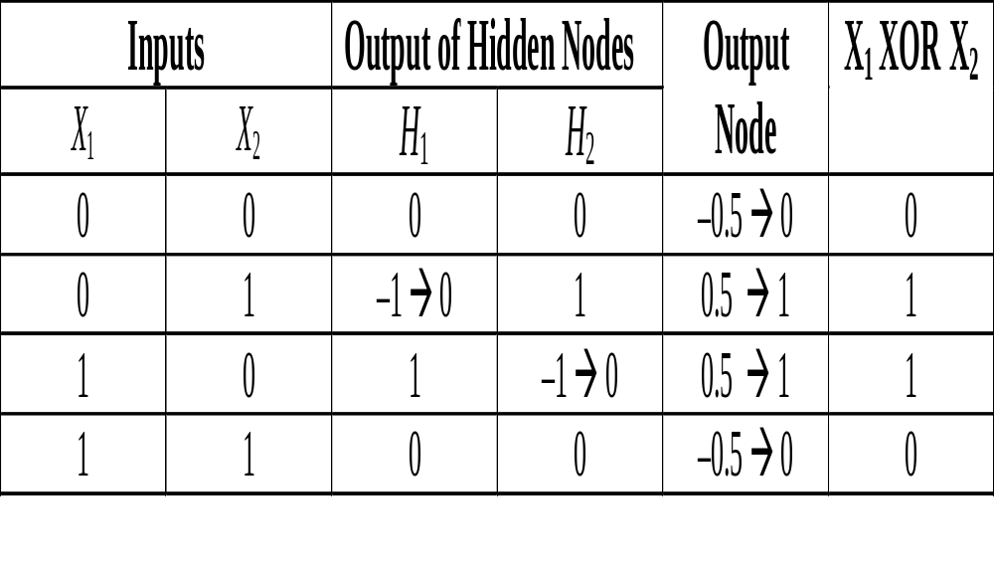
Since we are representing two states by 0 (false) and 1 (true), we will map negative outputs (–1, –0.5) of hidden and output layers to 0 and positive output (0.5) to 1.

Slide 27
Backpropagation
Back-propagation training algorithm
Backpropagation adjusts the weights of the NN in order to minimize the network total mean squared error.
Network activation
Forward Step
Error propagation
Backward Step

Slide 28
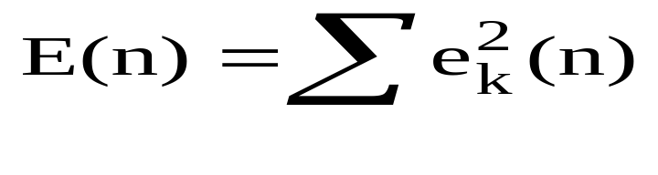
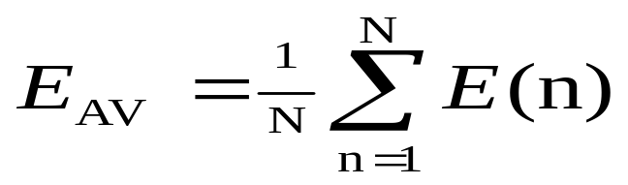
Total Mean Squared Error
The error of output neuron k after the activation of the network on the n-th training example (x(n), d(n)) is:
    e_{k}(n) = d_{k}(n) – y_{k}(n)
The network error is the sum of the squared errors of the output neurons:
The total mean squared error is the average of the network errors of the training examples.

Slide 29
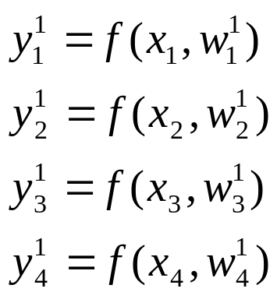
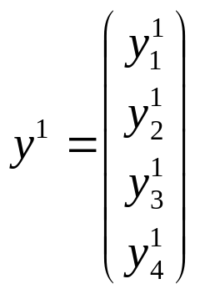
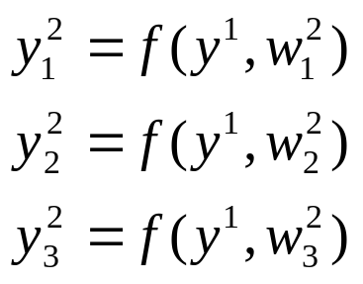
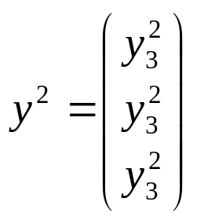

Neural network mathematics
Output
Inputs

Slide 30
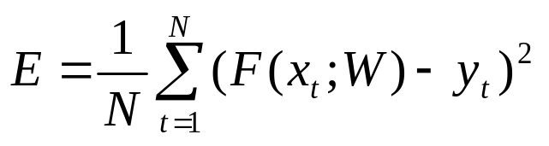
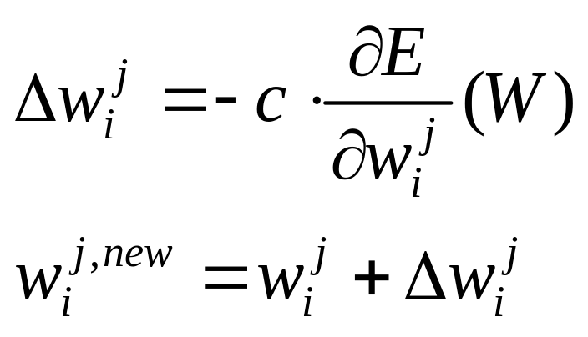
Learning to approximate
Error measure:
Rule for changing the synaptic weights:
c is the learning parameter (usually a constant)

Slide 31
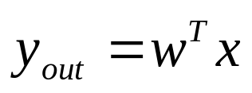
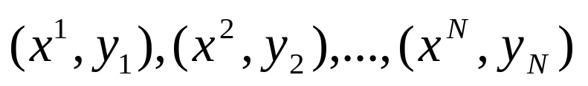
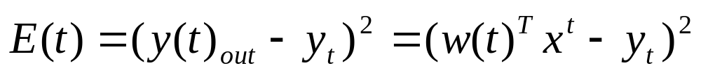
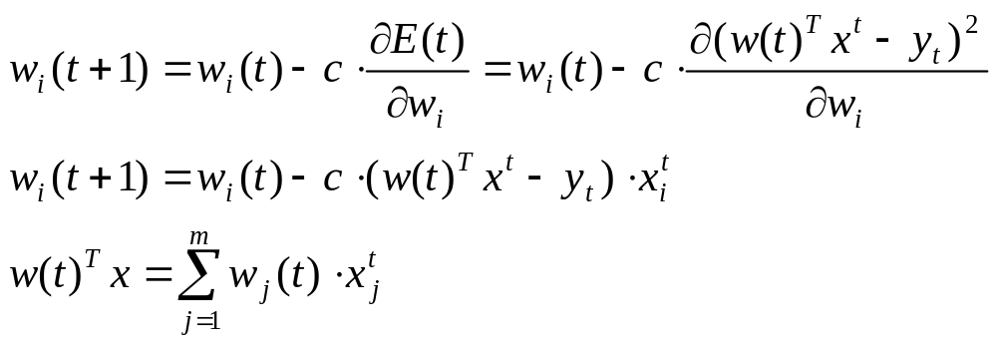
Learning with a perceptron
Perceptron:
Data:
Error:
Learning:
A perceptron is able to learn a linear function.

Slide 32
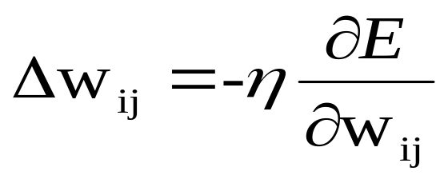
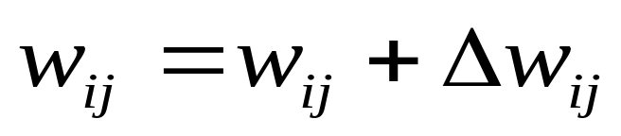
Weight Update Rule
The Backprop weight update rule is based on the gradient descent method:
  It takes a step in the direction yielding the maximum decrease of the network error E.
  This direction is the opposite of the gradient of E.
Iteration of the Backprop algorithm is usually terminated when the sum of squares of errors of the output values for all training data in an epoch is less than some threshold such as 0.01

Slide 33
Stopping criterions
Total mean squared error change:
  Back-prop is considered to have converged when the absolute rate of change in the average squared error per epoch is sufficiently small (in the range [0.1, 0.01]).
Generalization based criterion:
  After each epoch, the NN is tested for generalization.
  If the generalization performance is adequate then stop.
  If this stopping criterion is used then the part of the training set used for testing the network generalization will not used for updating the weights.

Slide 34
NN DESIGN ISSUES
Data representation
Network Topology
Network Parameters
Training
Validation

Slide 35
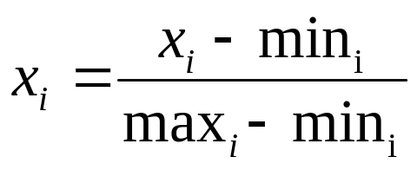
Data Representation
Data representation depends on the problem.
In general ANNs work on continuous (real valued) attributes. Therefore symbolic attributes are encoded into continuous ones.
Attributes of different types may have different ranges of values which affect the training process.
Normalization may be used, like the following one which scales each attribute to assume values between 0 and 1.
for each value x_{i} of i^{th} attribute, min_{i} and max_{i} are the minimum and maximum value of that attribute over the training set.

Slide 36
Network Topology
The number of layers and neurons depend on the specific task.
In practice this issue is solved by trial and error.
Two types of adaptive algorithms can be used:
  start from a large network and successively remove some neurons and links until network performance degrades.
  begin with a small network and introduce new neurons until performance is satisfactory.

Slide 37
Network parameters
How are the weights initialized?
How is the learning rate chosen?
How many hidden layers and how many neurons?
How many examples in the training set?

Slide 38
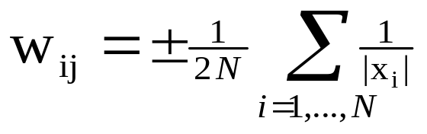
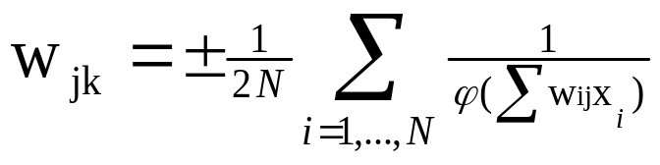
Initialization of weights
In general, initial weights are randomly chosen, with typical values between -1.0 and 1.0 or -0.5 and 0.5.
If some inputs are much larger than others, random initialization may bias the network to give much more importance to larger inputs.
In such a case, weights can be initialized as follows:
For weights from the input to the first layer
For weights from the first to the second layer

Slide 39
Choice of learning rate
The right value of η depends on the application.
Values between 0.1 and 0.9 have been used in many applications.
Other heuristics is that adapt η during the training.

Slide 40
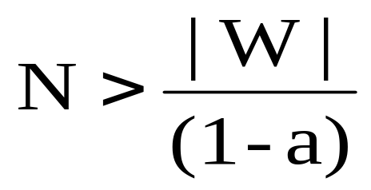
Training
Rule of thumb:
  the number of training examples should be at least five to ten times the number of weights of the network.
Other rule:
|W|= number of weights
a=expected accuracy on test set

Slide 41
Convergence and Local Minima
The error surface for multilayer networks may contain many different local minima.
BP guarantees to converge local minima only.
BP is a highly effective function approximator in practice.
  The local minima problem found to be not severe in many applications.

Slide 42
Notes
  Gradient descent over the complex error surfaces represented by ANNs is still poorly understood
  No methods are known to predict certainly when local minima will cause difficulties.
  We can use only heuristics for avoiding local minima.

Slide 43
Heuristics for Alleviating the Local Minima Problem
Add a momentum term to the weight-update rule.
Train multiple networks using the same data, but initializing each network with different random weights.
  Select the best network w.r.t the validation set
  Make a committee of networks

Slide 44
Why BP Works in Practice?
Weights are initialized to values near zero.
Early gradient descent steps will represent a very smooth function (approximately linear).
  The sigmoid function is almost linear when the total input (weighted sum of inputs to a sigmoid unit) is near 0.
The weights gradually move close to the global minimum.
As weights grow in the later stage of learning, they represent highly nonlinear network functions.
Gradient steps in this later stage move toward local minima in this region, which is acceptable.

Slide 45
Hidden Layer Representations
BP has an ability to discover useful intermediate representations at the hidden unit layers inside the networks which capture properties of the input spaces that are most relevant to learning the target function.
When more layers of units are used in the network, more complex features can be invented.
But the representations of the hidden layers are very hard to understand for human.

Slide 46
Generalization and Overfitting
Continuing training until the training error falls below some predetermined threshold is a poor strategy since BP is susceptible to overfitting.
  Need to measure the generalization accuracy over a validation set (distinct from the training set).
Two different types of overffiting
  Generalization error first decreases, then increases, even the training error continues to decrease.
  Generalization error decreases, then increases, then decreases again, while the training error continues to decreases.

Slide 47
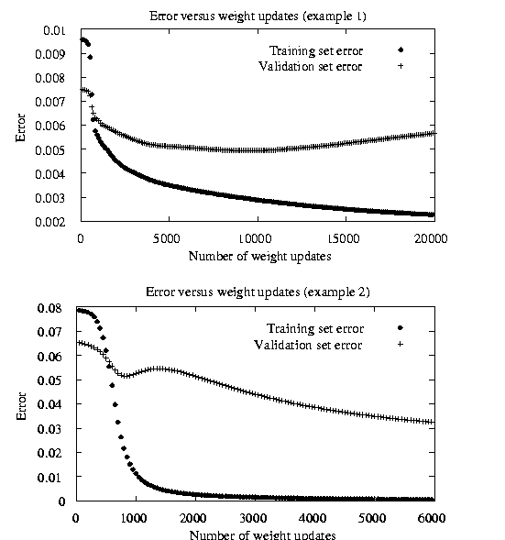
Two Kinds of Overfitting Phenomena

Slide 48
Techniques for Overcoming the Overfitting Problem
Weight decay
  Decrease each weight by some small factor during each iteration.
  This is equivalent to modifying the definition of E to include a penalty term corresponding to the total magnitude of the network weights.
  The motivation for the approach is to keep weight values small, to bias learning against complex decision surfaces.

Slide 49
k-fold cross-validation
  Cross validation is performed k different times, each time using a different partitioning of the data into training and validation sets
  The result are averaged after k times cross validation.

Slide 50
Now for some Practical Applications !

Slide 51
We have used..
Number of layers: 2 (i.e. 1 hidden layer with 20 neurons)
Transfer function: Hyperbolic tangent sigmoid
Network Type: Feed-forward network with backpropagation
Adaption Learning functions: Gradient descent weight and bias learning function (learngd)
Performance functions: Mean squared normalized error performance function (MSE)
Training fucntions: Gradient descent backpropagation (traingd) and Levenberg-Marquardt
backpropagation (trainlm)

Slide 52
It has two matrices:
1. stockInputs of order 16 x 330
2. stockTargets of order 1 x 330

Slide 53
The work flow for the problem has seven primary steps:
1. Collect data
2. Create the network
3. Congure the network
4. Initialize the weights and biases
5. Train the network
6. Validate the network
7. Use the network

Slide 54
The 16 input data values are the following:
1. CONSUMER DURABLES
2. CAPITAL GOODS
3. AUTO
4. BANKEX
5. FMCG
6. HEALTH CARE
7. IT
8. METAL
9. OIL and GAS
10. POWER
11. PSU
12. REALTY
13. TECK
14. USD TO INR
15. GBP TO INR
16. EURO TO INR

Slide 55
Matlab Implementation.

